Slide 1
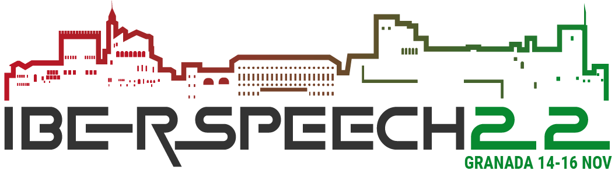

Assessing Transfer Learning and automatically annotated data in the development of Named Entity Recognizers for new domains
Emanuel Matos
Mário Rodrigues
António Teixeira
IEETA/DETI
Universidade de Aveiro
Portugal

Slide 2
Outline
Motivation
Main Objectives
Datasets
Our proposal
Results
Conclusions and Future Work

Slide 3
Motivation / Problem(s)
The identification of entities is a key step in many natural language processing (NLP) tasks
Consequently, named entity recognition (NER) is an important task in several contexts, text genres, and languages.
Common approach: ML …
Problem: Need for annotated data
The most recent proposed methods based on BERT to deal with the label scarcity problem using distant supervision.
The idea is to avoid the traditional labelling procedure by locating concepts in knowledge bases such as Wikipedia and YAGO in the target corpus.

Slide 4
Pretrained models and Transfer Learning
Pretrained models are biggest bottleneck preventing use of Named Entity Recognition.
The pressure of costs and time in the creation of annotated data for new domains, we proposed recently automatic annotation by an ensemble of NERs.
Train a Bidirectional Encoder Representations from Transformers (BERT) based NER for Portuguese and made a first evaluation a key step used in several natural language processing (NLP)

Slide 5
Recent work

Slide 6
Main Objectives
Machine learning systems were trained with data annotated by humans, at least in a revision stage.
Limitation in the development of NER for new domains, which are in large demand by the expansion of potential application areas.
To address this limitation developed NER systems for PT based on BERT using automatically annotated data.
Transfer Learning, finetuning pretrained BERT models with an automatically annotated dataset for the Tourism domain, based in Wikivoyage texts.

Slide 7
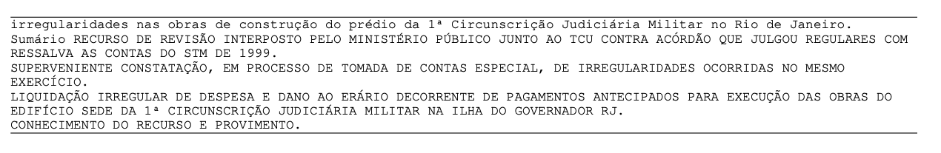
Datasets
Portuguese with Brazilian and European variants.
Dataset | Text Type | Language
Wikivoyage | Tourism | Portuguese
LeNer | Legal Documents | Portuguese
Paramopama | Extend WikiNer | Portuguese
Harem (*) | General | Portuguese
LeNer example:

Slide 8
Proposed Solution
NER with cross-domain and transfer learning

Slide 9
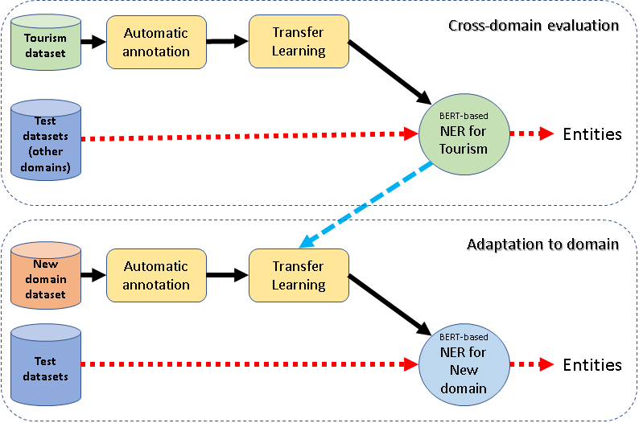
Proposed Method: NER with cross-domain and transfer learning
The process consists of two parts:
Cross-domain application of a BERT-based NER model previously trained with automatically annotated data
(top part of the Figure)
Fine-tuning of this base model to a new domain resorting to automatically annotated data for that domain.

Slide 10
Cross-domain evaluation
To assess the potential of the pretrained models in a new domain,
BERT-based NER models were used without any additional training

Slide 11
Fine-tuning NER model to a new domain
Additional training was applied to the BERT model pretrained with Tourism data, using part of the LeNER legal dataset.
Due to problems with 3 of the 60 texts of this dataset, 47 texts were used for training and 10 for test.
New models were trained with 20%, 40%, 60%, 80% and all of the tokens of the training data
to make possible evaluation of the effect of the amount of additional training data,
As a result 5 new models were obtained.
They were assessed following a similar process to the one used for the initial model for Tourism domain.

Slide 12
Evaluation
assessed following a similar process to the one used for the initial model for Tourism domain
The performance was evaluated using the standard metrics (Precision, Recall and F1) considering the individual words of the entity.

Slide 13
Results

Slide 14
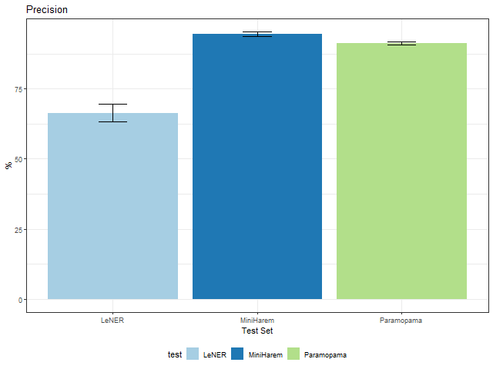
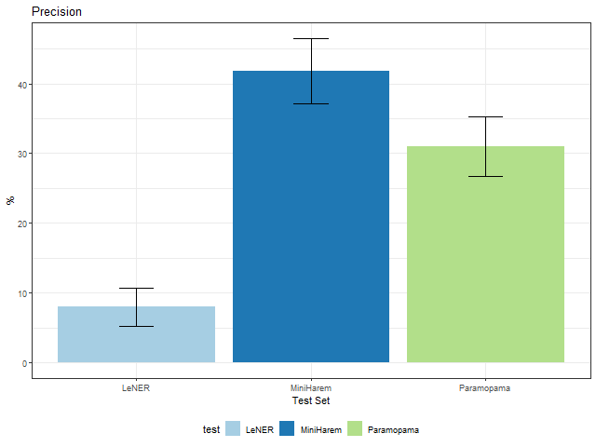
Global Results – ½ → Cross-domain results ?
The performance was evaluated using the standard metrics (Precision, Recall and F1) considering the individual words of the entity.

Slide 15
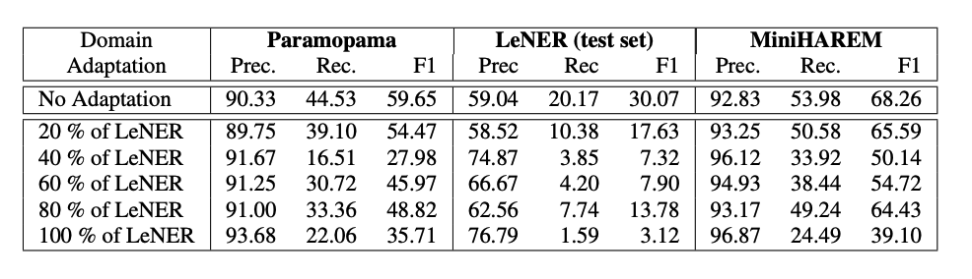
Global Results – 2/2
The results for the selected metrics as function of the NER model and test-set are presented in Table.

Slide 16
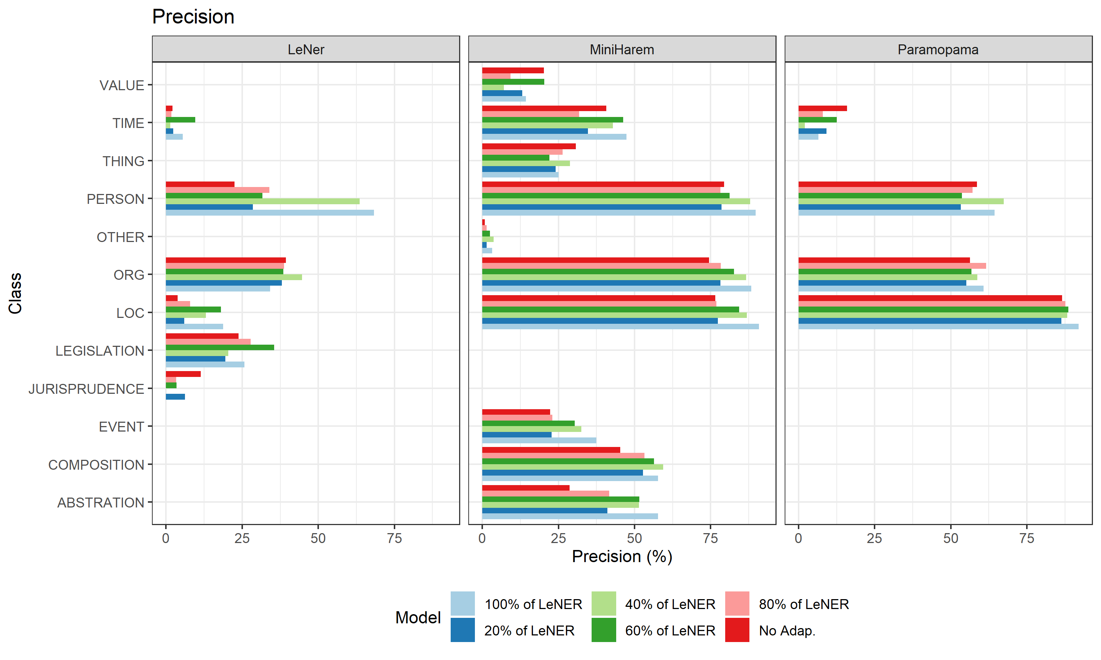
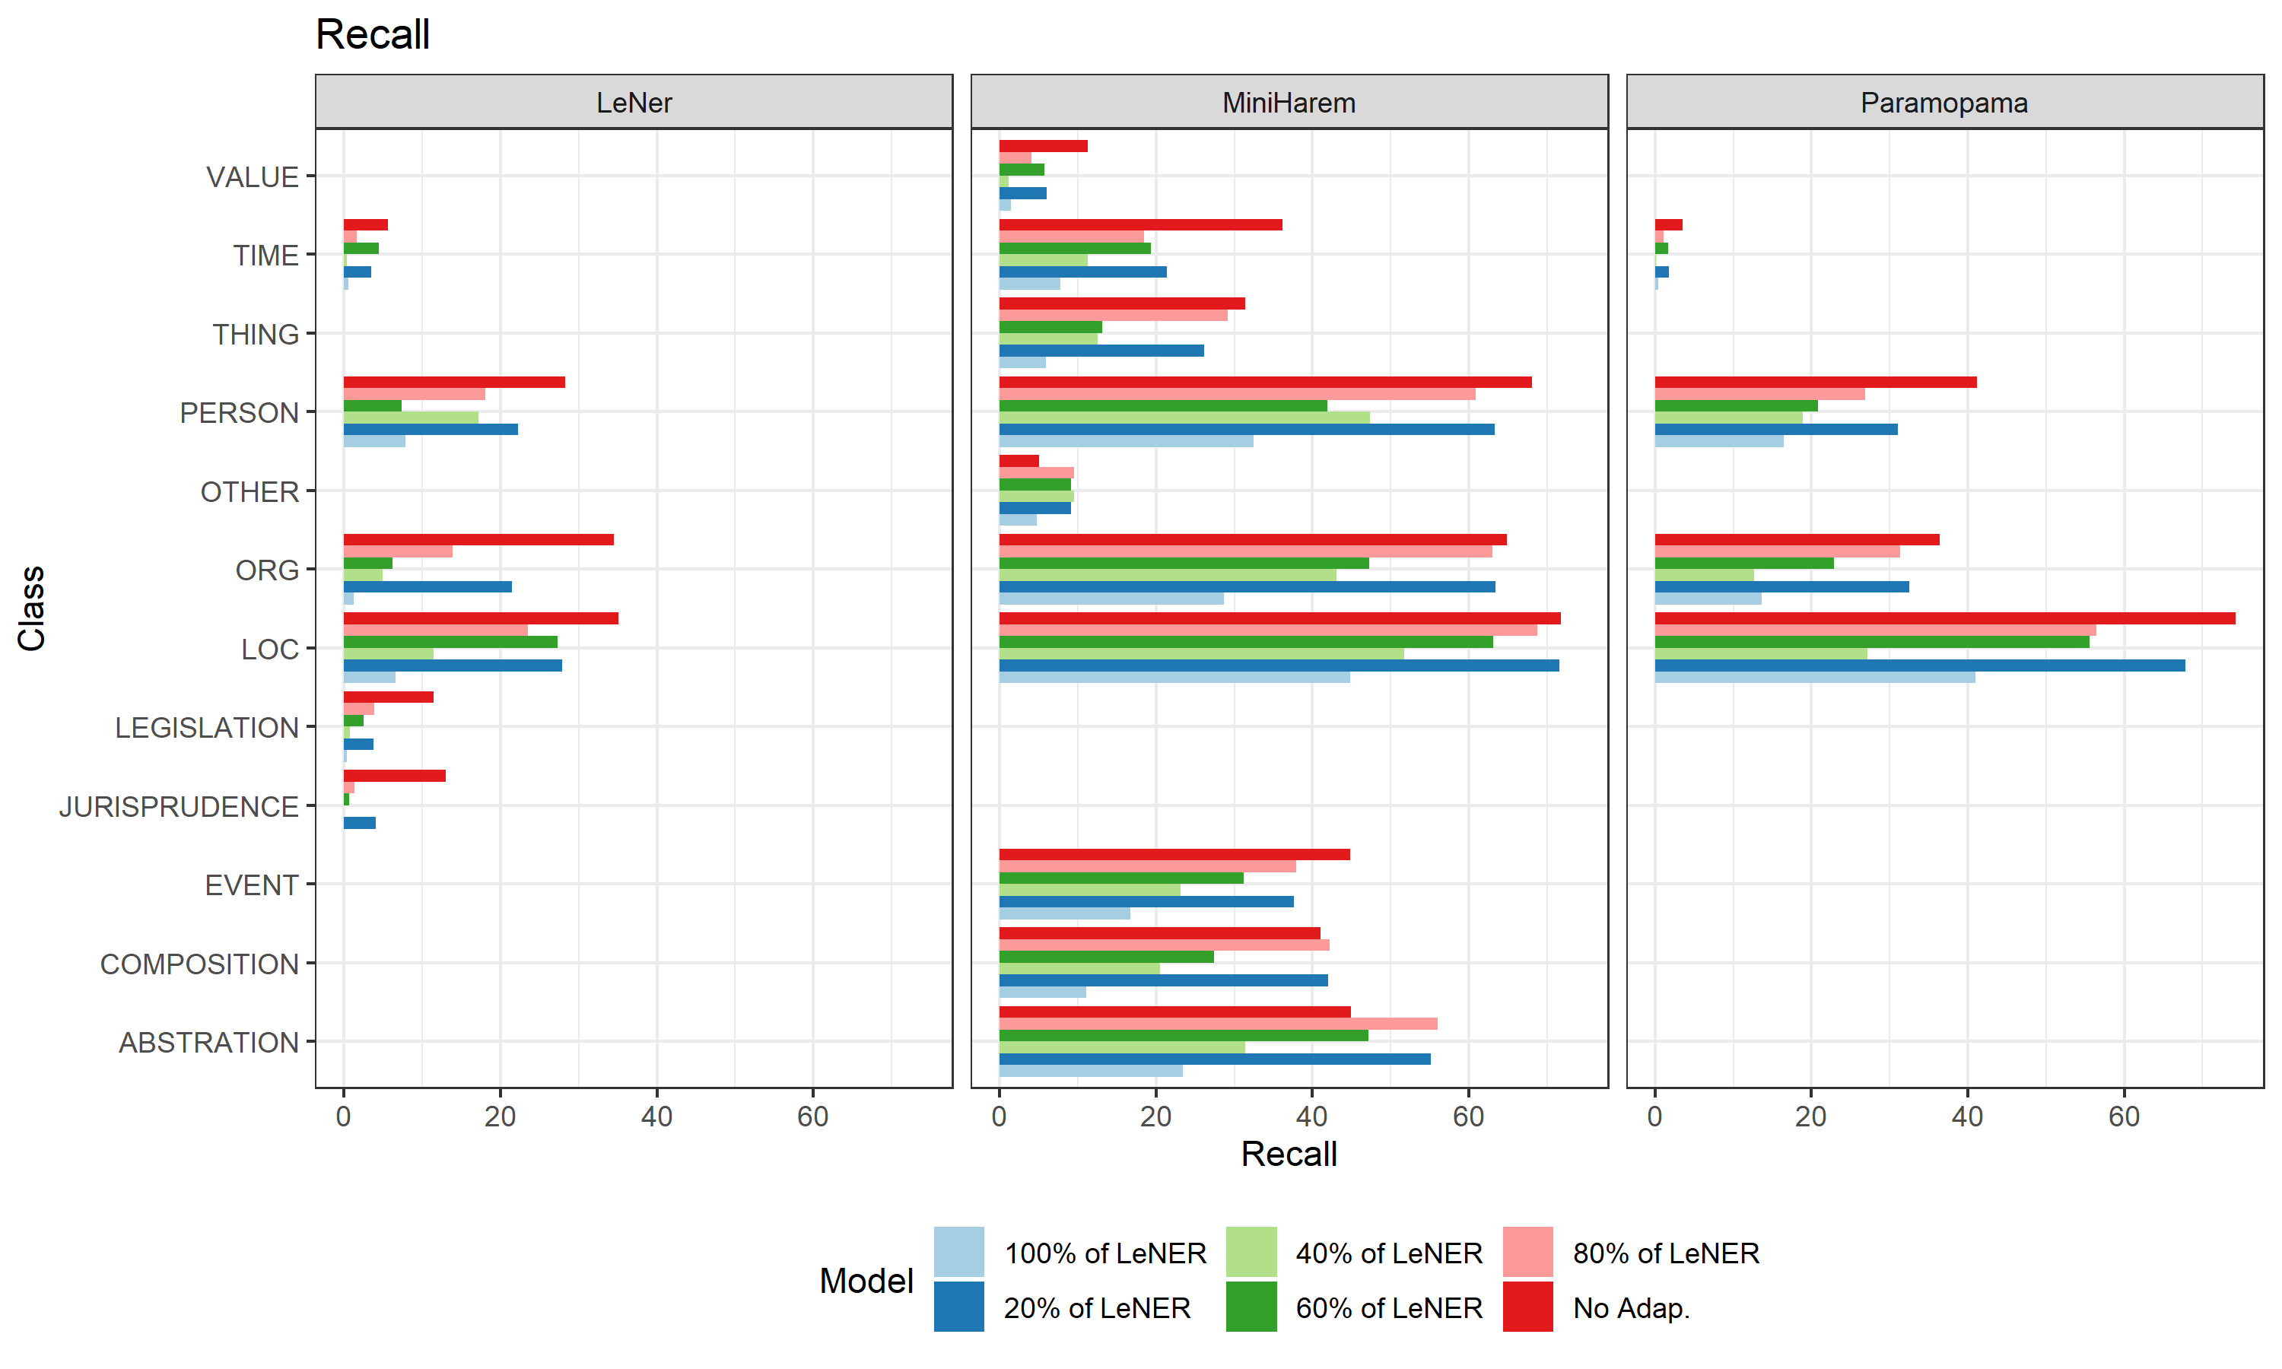
Performance by entity type
The best results were obtained for PERSON, ORGanization and LOCation, being lower for LeNER.
The best Precision in LeNER was obtained for PERSON
with values similar to Paramopama and close to 70%.
Recall, in general lower than Precision, presents high variation across entity classes, and is more affected than Precision by the additional training.

Slide 17
Conclusion
Addressing the problem of development of NERs for new domains without annotated datasets, explores the cross-domain potential of application of BERT-based NER models with and without tuning with in-domain additional training.
Good results were obtained without any additional training with the Paramopama dataset, corroborating the previous results pointing to the capability of generalization of the BERT-based models.
The results for the legal domain (LeNER dataset) were lower.
Nevertheless, without any in-domain training, models maintained a Recall above 30% for classes PERSON, ORGANIZATION and LOCATION,
that we can qualify as interesting considering the specificities of this dataset, particularly the exaggerated use of capitalized words.

Slide 18
Future work
The results point to the potential of the approach but many challenges and limitations remain.
Future work will include:
improvement of the quality of the dataset obtained for the new domain,
by post-processing of the annotations to solve problems detected (e.g., first word of a sentence considered an entity)
development of new models specialized in only one entity class (e.g., PERSON) instead the multi-class models explored so far
exploration of the potential of bootstrapping methods in the creation of NER for new classes introduced by a new domain
as the LEGISLATION in LeNER dataset
exploration of recent alternatives to BERT,
such as GPT-3 or FLAN;

Slide 19
Acknowledgement
This research was supported by IEETA Research Unit, funded by National Funds through the FCT - Foundation for Science and Technology, in the context of the project UIDB/00127/2020.

Slide 20

Thanks for your attention. Any questions?

